Slide 1
WebRTC 를 이용한 양방향 화상 통신 프론트앤드 개발 및 시그널서버개발 - #3
2018.01
백지훈
jhbaik@moberan.com
이 문서는 나눔글꼴로 작성되었습니다. 설치하기

Slide 2
강의소개
1.1 강의소개
2 / 14
3일차 :
RTCPeerConnection API 소개.
OFFER-ANSWER Model
SDP (Session Description Protocol)
ICE (Interactive connectivity establishment)
SignalServer 없이 P2P로 1:1 통신 제작

Slide 3
개발환경
개발환경
3 / 14
언어
HTML
JAVASCRIPT
개발툴
마음대로
권장 -> VS Code
실행환경
Chrome (권장) + WS for Chrome
Github Pages
Why? = Because We need HTTPS.

Slide 4
강의소개
1.1 강의소개
4 / 14

Slide 5
개발환경
개발환경
5 / 14
VisualStudio Code : https://code.visualstudio.com/
Chrome
https://www.google.co.kr/chrome/browser/desktop/index.html
Web server for chrome
https://chrome.google.com/webstore/detail/web-server-for-chrome/ofhbbkphhbklhfoeikjpcbhemlocgigb?hl=en

Slide 6
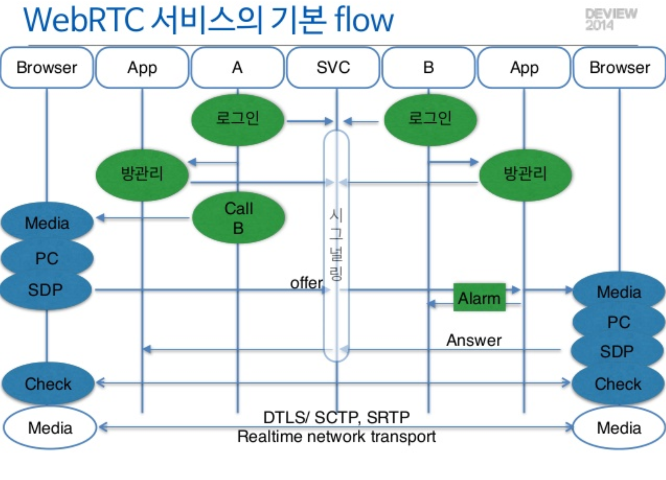

Slide 7
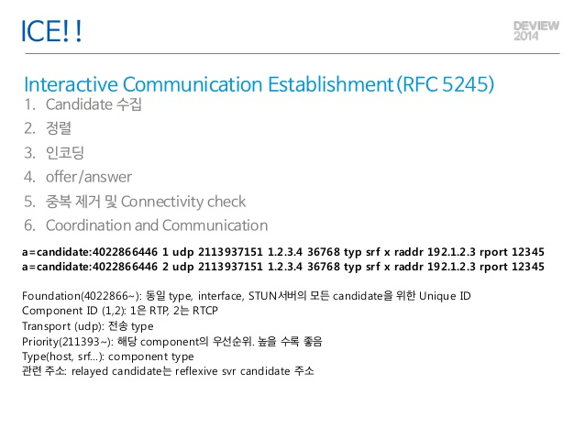

Slide 8
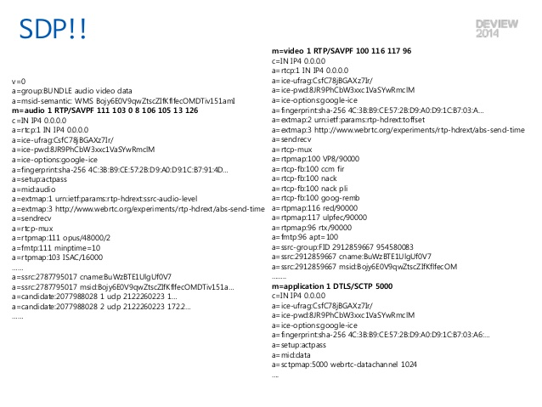

Slide 9
WebRTC API
MediaStream (getUserMedia)
9 / 14
Main Feature
getUserMedia
비디오와 오디오 스트림 얻기
RTCPeerConnection
Peer to Peer 비디오 오디오 통신
RTCDataChannel
Peer to Peer 실시간 데이터 통신

Slide 10
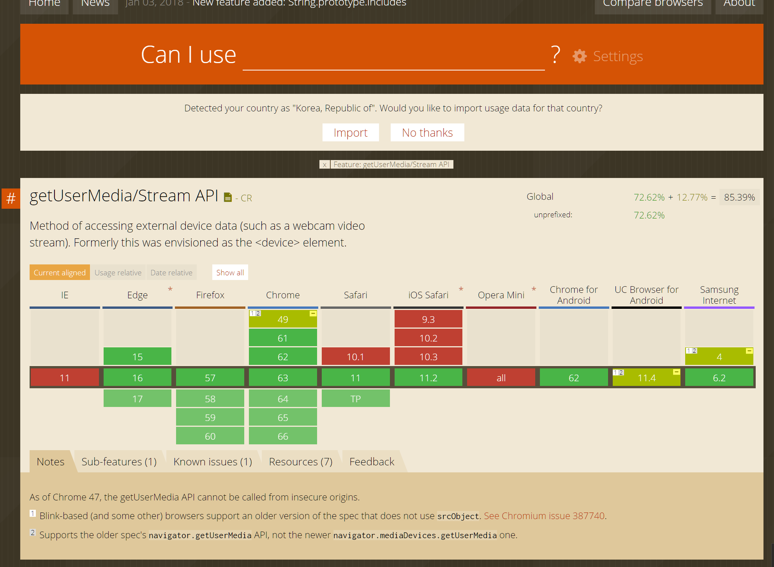
브라우저 지원 상황
MediaStream (getUserMedia)
10 / 14
https://caniuse.com/#feat=stream

Slide 11
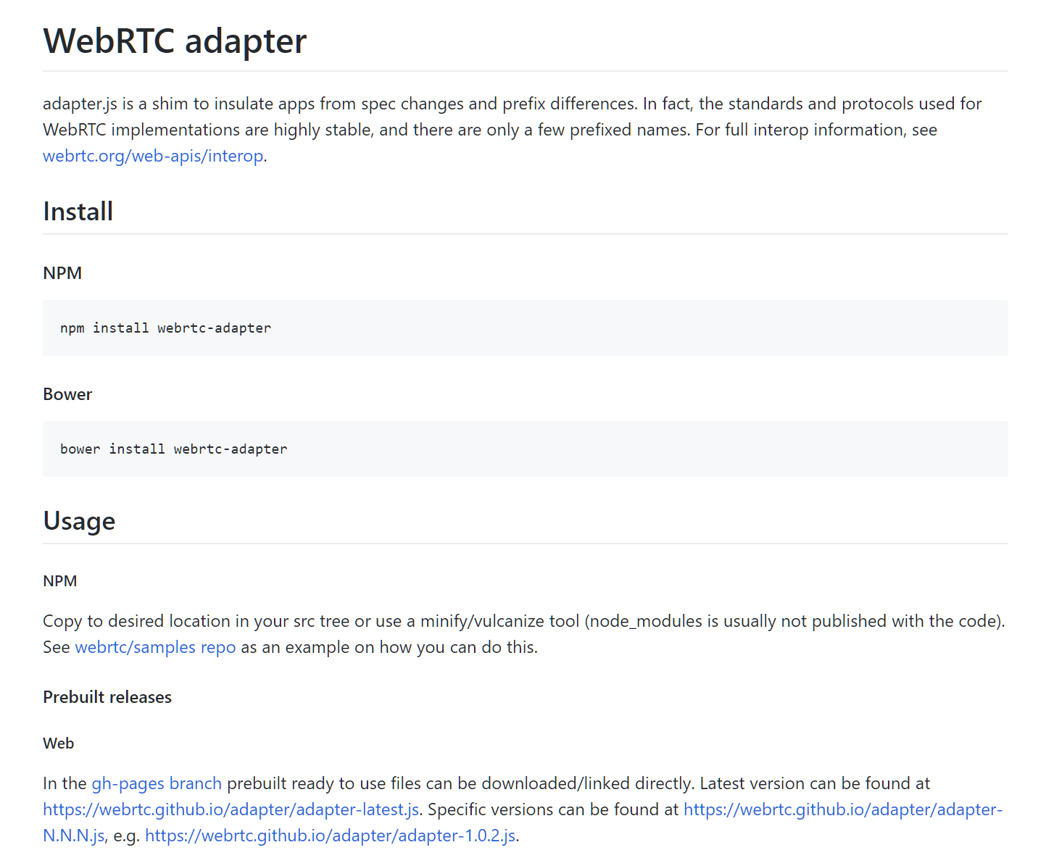
Adapter.js
Adapter.js
11 / 14
https://github.com/webrtc/adapter
브라우저마다 API조금씩 다른 WebRTC.
adapter.js를 사용해야 그 호환성을 지킬 수 있다.

Slide 12
MediaStream 예제
WebRTC
https://appr.tc
Webcam Toy
https://webcamtoy.com/app/
ASCII Camera
https://idevelop.ro/ascii-camera/

Slide 13
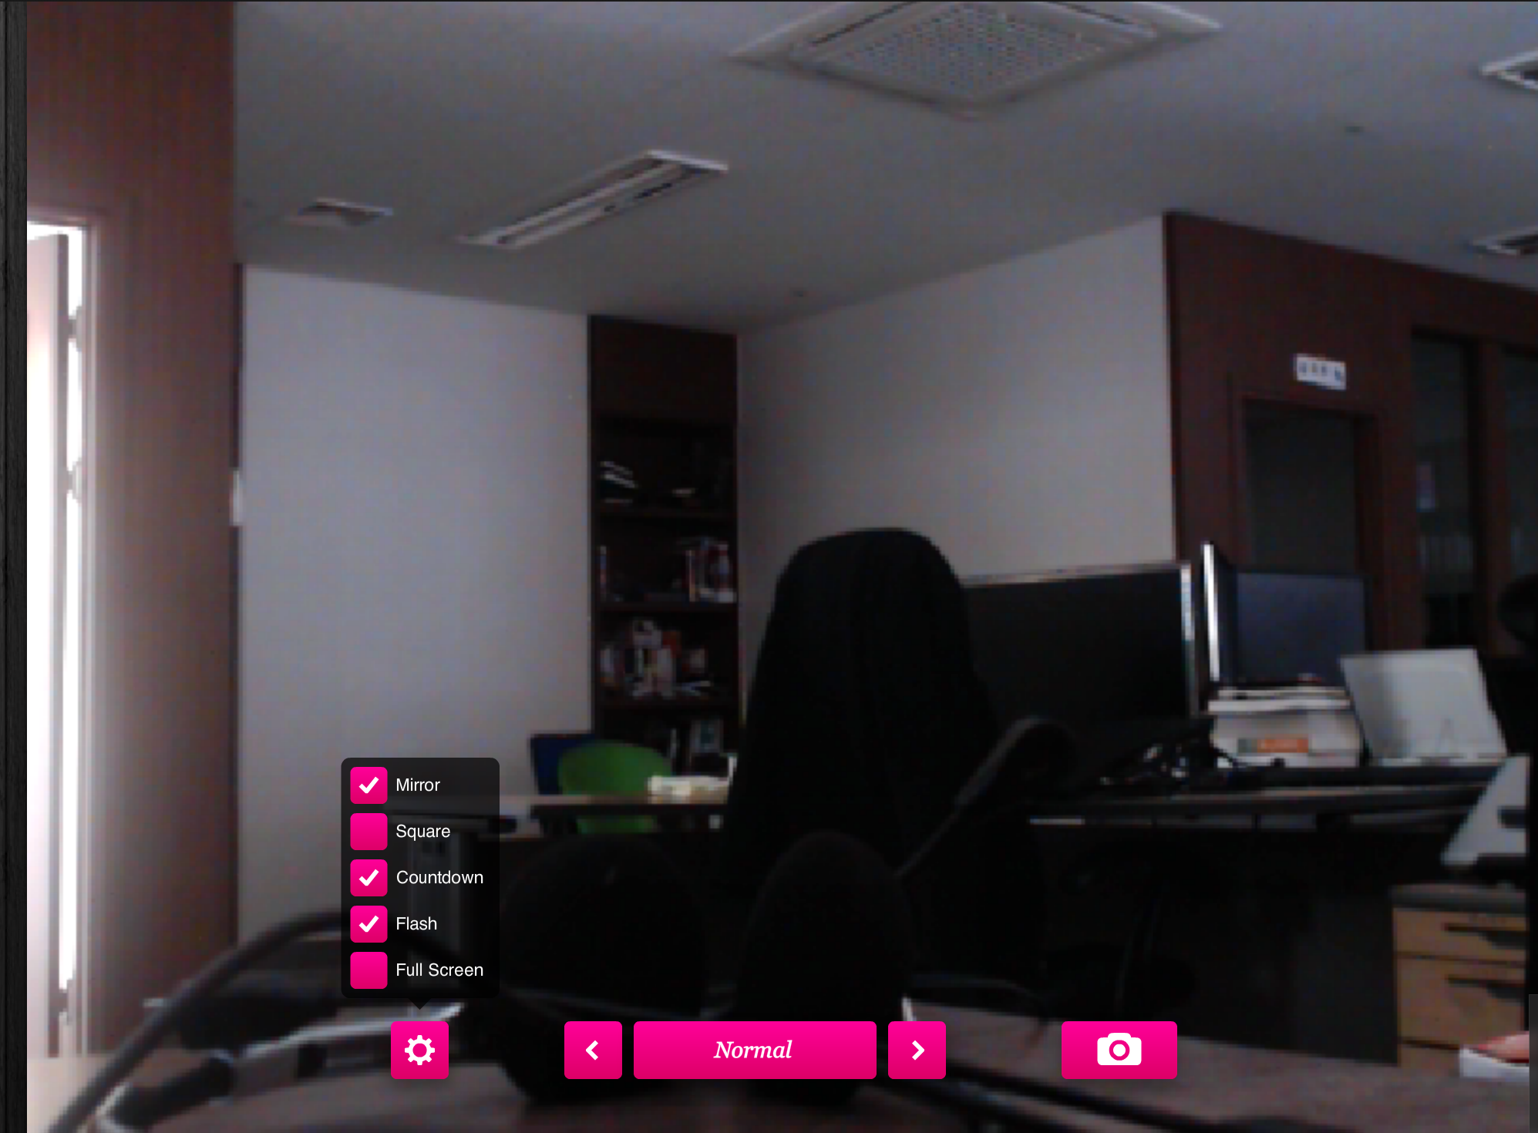

Slide 14
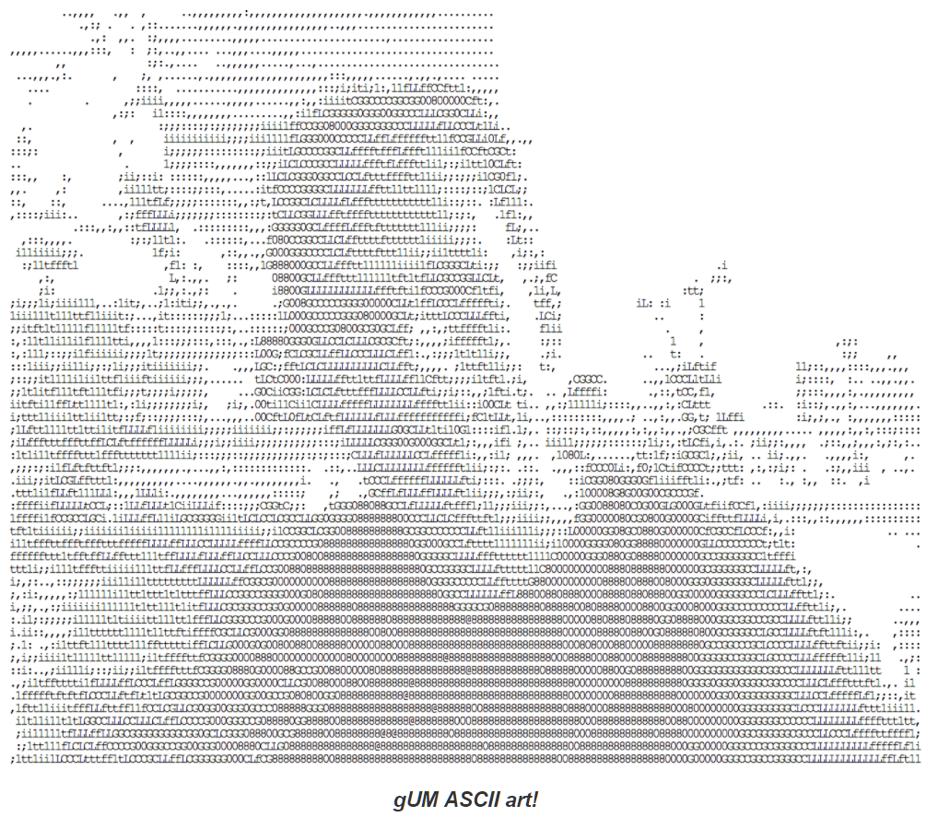

Slide 15
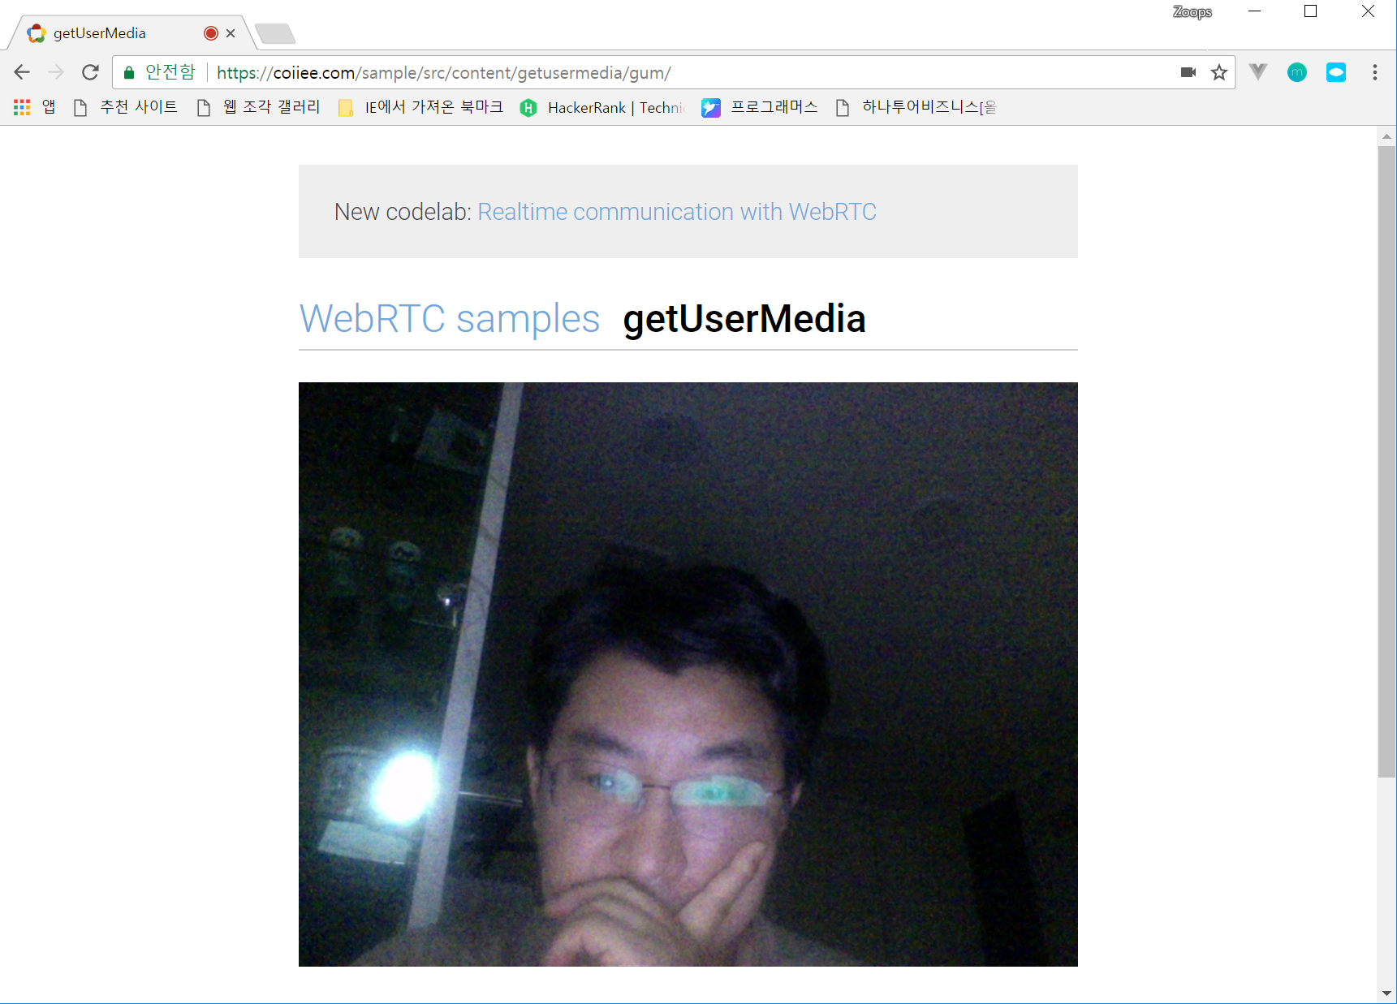
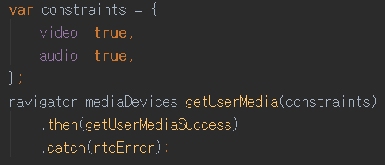
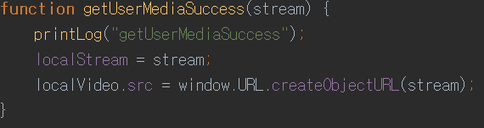
MediaStream (getUserMedia)
MediaStream (getUserMedia)
15 / 14
미디어의 스트림을 얻어내는 MediaStream의 API
https://developer.mozilla.org/en-US/docs/Web/API/MediaDevices/getUserMedia

Slide 16
예전방식
navigator.getUserMedia(constraints, successCallback, errorCallback);
콜백 함수를 파라메터로 보내서 처리.

Slide 17
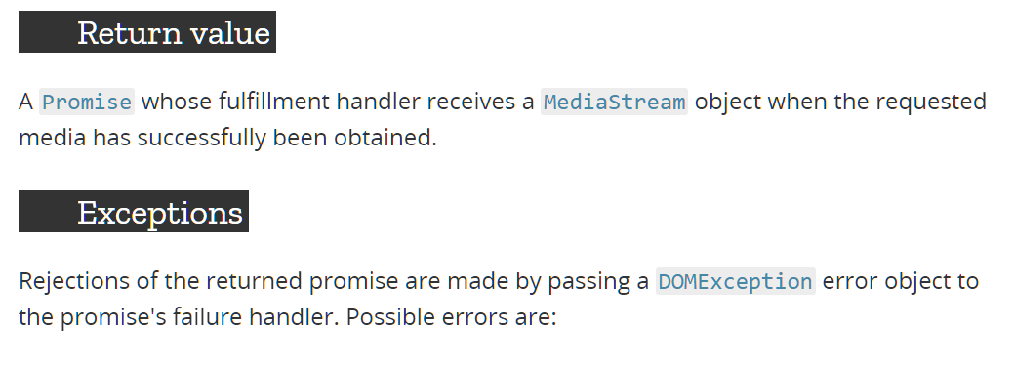
현재 Syntax : promise 로 처리
var promise =
navigator.mediaDevices.getUserMedia(constraints);
Parameters

Slide 18
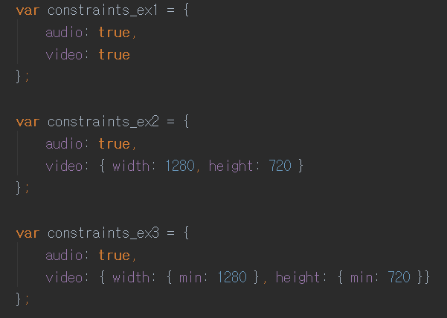
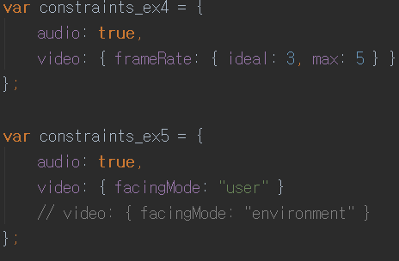
constraints
MediaStream (getUserMedia)
18 / 14
Audio / video : 사용여부
Video 크기 : width / height , min / ideal / max
Video frame rate : min / ideal / max
facingMode : 앞면 카메라 (user) / 후면 카메라(environment) / 카메라이름 (기타)
등등

Slide 19
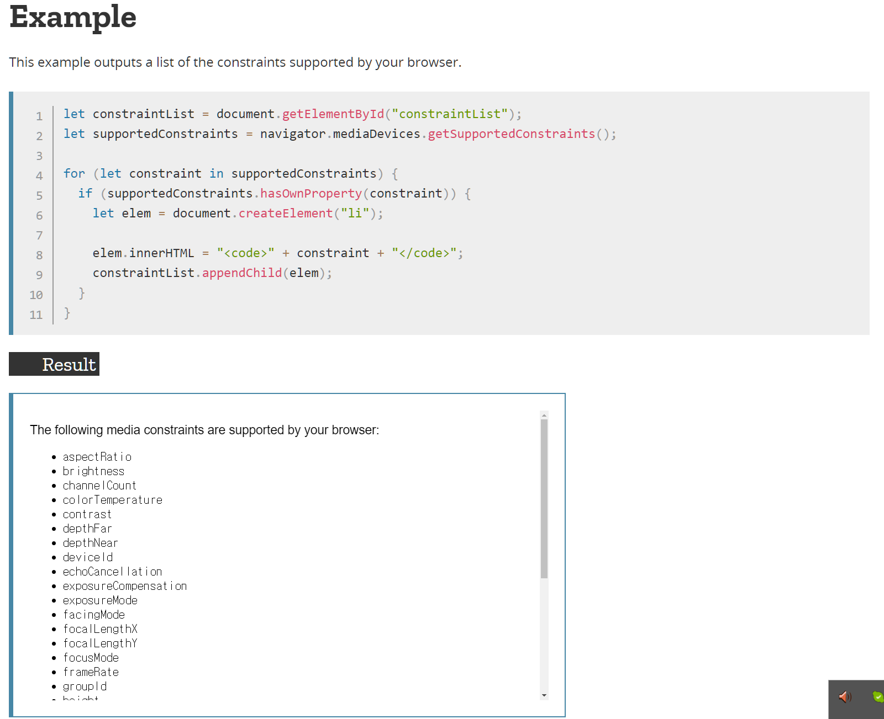
지원되는 제약사항 조회
Syntax
var supportedConstraints =
navigator.mediaDevices.getSupportedConstraints();

Slide 20
2. MediaStream (getUserMedia)
20 / 14
'use strict';
navigator.getUserMedia = navigator.getUserMedia ||
navigator.webkitGetUserMedia || navigator.mozGetUserMedia;
var constraints = {
audio: false,
video: true
};
var video = document.querySelector('video');
function successCallback(stream) {
window.stream = stream; // stream available to console
if (window.URL) {
video.src = window.URL.createObjectURL(stream);
} else {
video.src = stream;
}
}
function errorCallback(error) {
console.log('navigator.getUserMedia error: ', error);
}
navigator.getUserMedia(constraints, successCallback, errorCallback);
<!DOCTYPE html>
<html> <head> <title>Realtime communication with WebRTC</title> <link rel="stylesheet" href="css/main.css" /> </head> <body> <h1>Realtime communication with WebRTC</h1> <video autoplay></video> <script src="js/main.js"></script> </body> </html>

Slide 21
<!DOCTYPE html>
<!--
* Copyright (c) 2015 The WebRTC project authors. All Rights Reserved.
*
* Use of this source code is governed by a BSD-style license
* that can be found in the LICENSE file in the root of the source
* tree.
-->
<html>
<head>
<meta charset="utf-8">
<meta name="description" content="WebRTC code samples">
<meta name="viewport" content="width=device-width, user-scalable=yes, initial-scale=1, maximum-scale=1">
<meta itemprop="description" content="Client-side WebRTC code samples">
<meta itemprop="image" content="../../../images/webrtc-icon-192x192.png">
<meta itemprop="name" content="WebRTC code samples">
<meta name="mobile-web-app-capable" content="yes">
<meta id="theme-color" name="theme-color" content="#ffffff">
<base target="_blank">
<title>getUserMedia</title>
<link rel="icon" sizes="192x192" href="../../../images/webrtc-icon-192x192.png">
<link href="//fonts.googleapis.com/css?family=Roboto:300,400,500,700" rel="stylesheet" type="text/css">
<link rel="stylesheet" href="../../../css/main.css">
</head>
<body>
<div id="container">
<div class="highlight">
<p>New codelab: <a href="https://codelabs.developers.google.com/codelabs/webrtc-web">Realtime communication with WebRTC</a></p>
</div>
<h1><a href="//webrtc.github.io/samples/" title="WebRTC samples homepage">WebRTC samples</a> <span>getUserMedia</span></h1>
<video id="gum-local" autoplay playsinline></video>
<div id="errorMsg"></div>
<p class="warning"><strong>Warning:</strong> if you're not using headphones, pressing play will cause feedback.</p>
<p>Display the video stream from <code>getUserMedia()</code> in a video element.</p>
<p>The <code>MediaStream</code> object <code>stream</code> passed to the <code>getUserMedia()</code> callback is in global scope, so you can inspect it from the console.</p>
<a href="https://github.com/webrtc/samples/tree/gh-pages/src/content/getusermedia/gum" title="View source for this page on GitHub" id="viewSource">View source on GitHub</a>
</div>
<script src="https://webrtc.github.io/adapter/adapter-latest.js"></script>
<script src="../../../js/common.js"></script>
<script src="js/main.js"></script>
<script src="../../../js/lib/ga.js"></script>
</body>
</html>
'use strict';
var errorElement = document.querySelector('#errorMsg');
var video = document.querySelector('video');
var constraints = window.constraints = {
audio: true,
video: true
};
function handleSuccess(stream) {
var videoTracks = stream.getVideoTracks();
var audioTracks = stream.getAudioTracks();
window.stream = stream;
video.srcObject = stream;
}
function handleError(error) {
errorMsg('getUserMedia error: ' + error.name, error);
}
function errorMsg(msg, error) {
errorElement.innerHTML += '<p>' + msg + '</p>';
if (typeof error !== 'undefined') {
console.error(error);
}
}
navigator.mediaDevices.getUserMedia(constraints).
then(handleSuccess).catch(handleError);

Slide 22
감사합니다
이 문서는 나눔글꼴로 작성되었습니다. 설치하기

